Slide 1
Chinese Text Clustering Method Based on Semantics and Special Domain

Slide 2
Abstract
In view of ignoring semantic relationship between words, high dimensionality of data and computational complexity when current text clustering algorithms deal with Chinese texts.
This paper presents a new method to cluster Chinese texts based on semantics in a specific field-TCBS (Text Clustering Based on Semantics) algorithm. The algorithm is based on the agglomerative hierarchical clustering algorithm, it expresses Chinese texts with the characteristic words and sets relative threshold in order to improve the efficiency of clustering. Compared with the traditional algorithms, the experimental results show that TCBS has effectively enhanced the quality of the clustering.

Slide 3
Introduction
Text clustering divides the document collections into several clusters in the absence of any unforeseen circumstances. The similarity of texts within one cluster should be as much as possible, while it should be as small as possible between different clusters in order to find distribution of the collections of the entire texts.
Based on techniques[1][2] of dealing with and researching documents and research and analysis of current text clustering algorithms [3][4], this paper proposes a new method-TCBS. We could use text as list of characteristic words and take semantic similarity between characteristic words as criteria of measure of similarity between texts, meanwhile, set up relevant threshold based on agglomerative hierarchical clustering and keep updating representative points when clustering. The method could effectively enhance the quality of Chinese text clustering in some field.

Slide 4

Related Works
Text representation
  VSM
  A concept-based text representation model
Similarity computation
  Tree-like:
  Using attributes of concept
Text clustering algorithms

Slide 5
Problems
High data dimensionality
Efficiency of calculating the similarity
Chinese word’s semantic similarity
How to choose the representative point

Slide 6
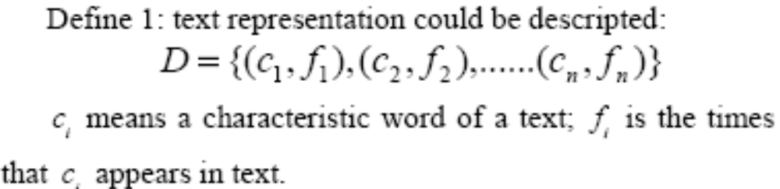
The representation of characteristic words in the list
In TCBS we take those semantically labeled characteristic words to express text, which could solve the problem of Chinese text representation. After the Segmentation of the text, the relationship between words can be divided into synonyms, antisense, from top to bottom, and part of relationships. With from top to bottom we could define words’ semantic categories, tag semantic categories on words and abstract text to a high semantic level. In the same field, one word usually has one meaning and corresponding to only one semantic tag, we could extract those marked words after semantically tagging. This paper defines text representation as follows:

Slide 7
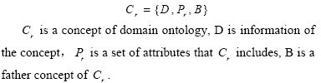
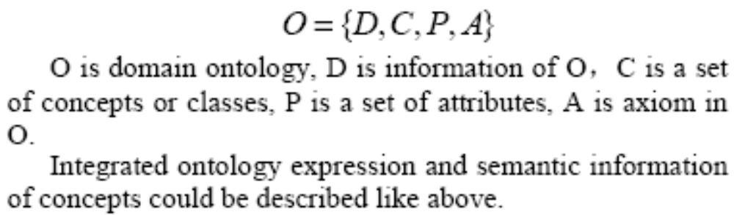
Domain Ontology and Formal Representation of the Concept
Definition 2: The description of Concepts (Class) is:
Definition 3 ： domain ontology can be expressed as follows：

Slide 8
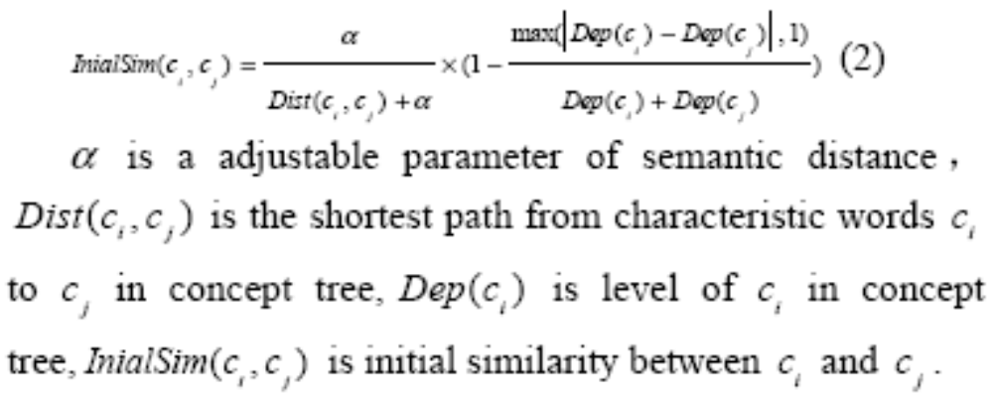
General Similarity
A. Initial similarity based on semantic distance

Slide 9
B. Attributes similarity based on attributes
  Because attributes also takes a great position in concept. If two concepts have the same attributes, they are the same; if two concepts have similar attributes, then the two concepts are similar.

Slide 10
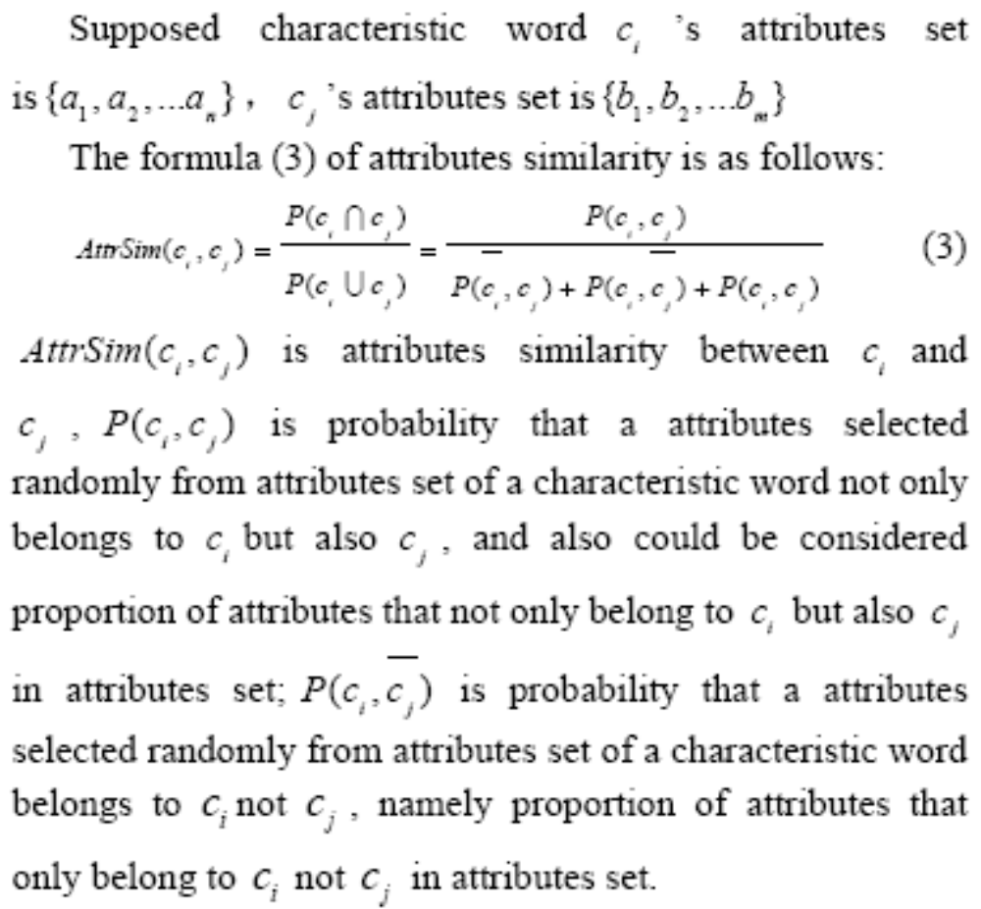

Slide 11
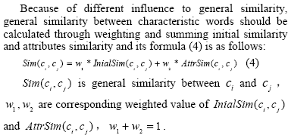
C. General similarity between characteristic words

Slide 12
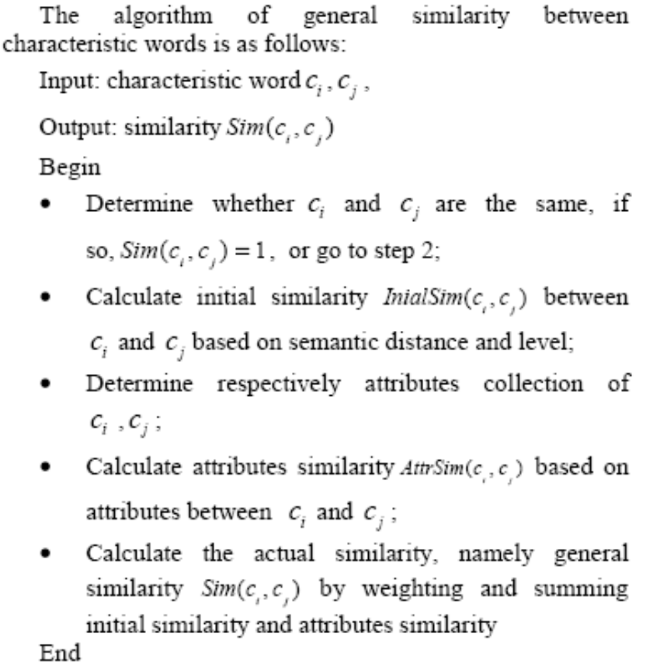

Slide 13
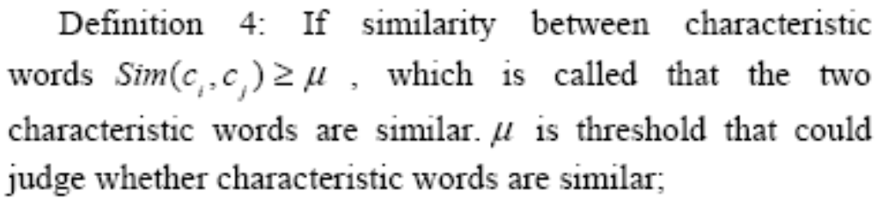
Similarity between Texts
Calculate respectively the number of characteristic words that document 1 and document 2 have and that belong to both of them, if the number is greater than a set value, the two documents are considered similar, and could be classified as a class ;

Slide 14
When calculating the similarity of two documents, first pick up one characteristic word to calculate with all the words of document 2 until all the words of document 1 is cycled. If the number that characteristic words of documents are similar is greater than a set value, then the two documents could be classified to a cluster, or they have different category;
Count and pick up all the characteristic words that belong to both of the two documents or similar to update representative points of class that document belong to, which not only uses weighted similarity of all the characteristic words but also considers the quantity of similar characteristic words. Definitely it could accurately determine whether two documents are similar or not.

Slide 15
TCBS
A. Choice of representative points of cluster
  If each of the two classes contains only one text, extract characteristic words same or similar and high frequency from the two texts as representative points of new class when merging two classes to a new one;
  If one class has one text and the other has many texts, extract characteristic words of the same or similar and high frequency from the text and representative points of the other as representative points of new class when merging two classes to a new one.
  If two classes both contain many texts, extract characteristic words of same or similar and high frequency from the two classes as representative points of new class when merging every two classes to a new one.

Slide 16
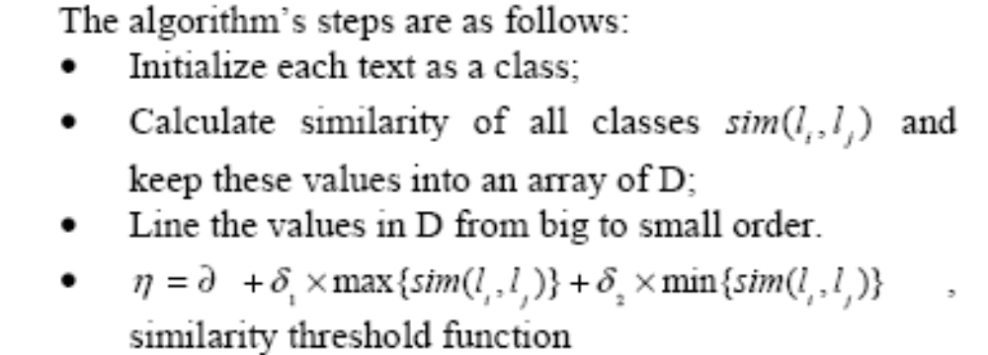
B. TCBS realization

Slide 17
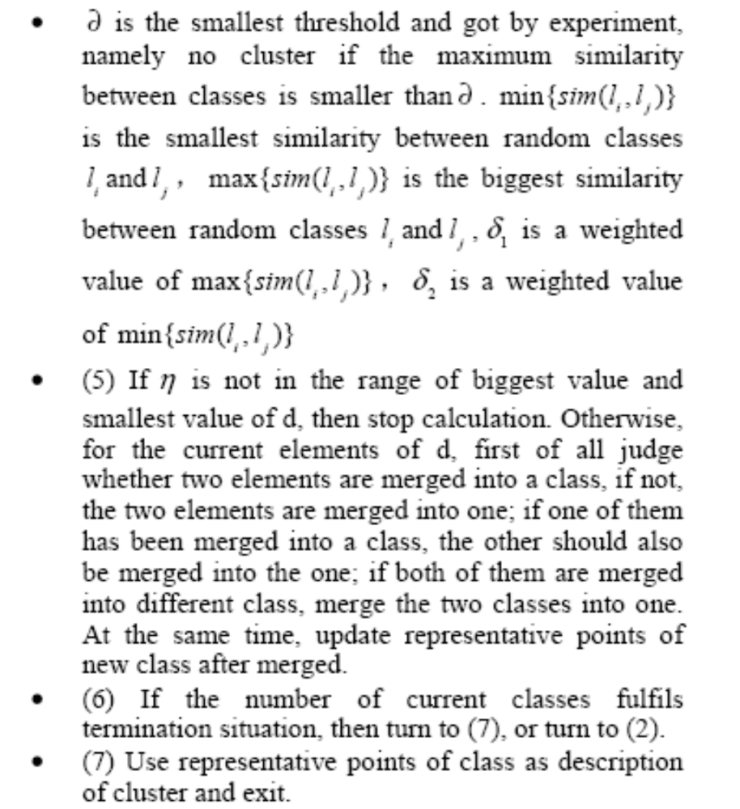

Slide 18
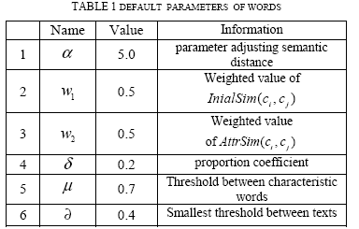
The Experimental Results and Analysis
Experimental corpus is 200 texts about sport collected from news websites like www.sina.com and www.sohu.com. After organizing and classifying correlative professional words from these texts, we could use Protege3.0 to construct domain ontology knowledge database and Jena2.4 to analyze ontology and semantically tag texts. Default parameters of the system are shown in Table 1 as follows:

Slide 19
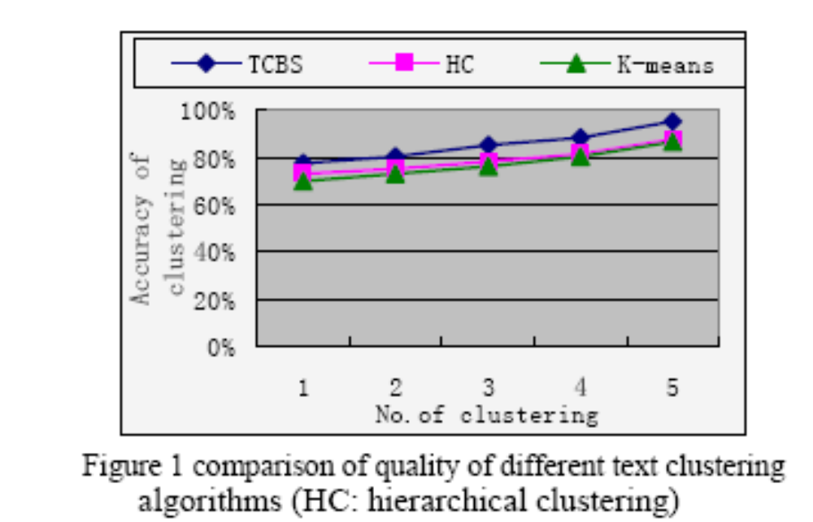
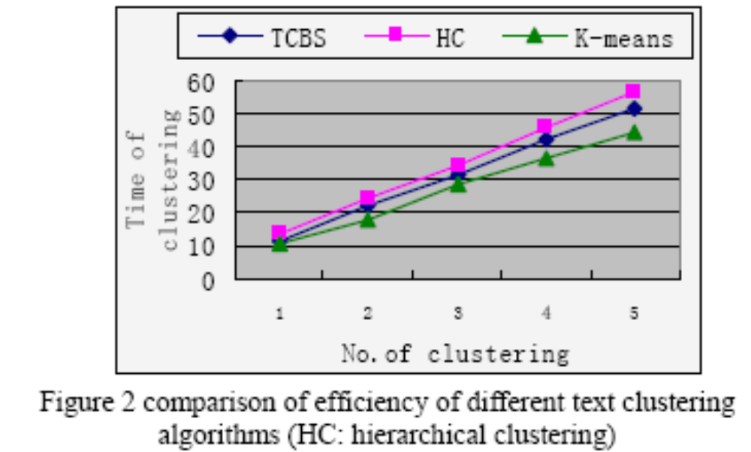

Slide 20
Thanks~

